Slide 1

QF 621 Quantitative Trading Strategy 10 Jul 2021
Members:
Ankit RAWAT
CHUA Wen Bin
POH Mei Yi
SZE THO Ryan
WONG Boon Fuei, Lawrence
ZHANG Chuanyu

Slide 2

Overview- Purpose & Findings
The purpose of this research is to discern yield enhanced systematic strategy for forex trading, by comparing the performance of an individual strategy vs a portfolio of strategies.
We look at four strategies- pairs trading, carry trade, momentum and value strategy. We then compared the individual strategy performance with a combined strategy using equal weights.
Preliminary findings show a superior Sharpe Ratio for Pairs & Carry Trade, and points towards our hypothesis of enhanced yield from a portfolio strategy approach.
Notes:
Focus is on Forex, large transaction volumes.
Purpose is to test the hypothesis that yields can be enhanced by a combination of FX systematic strategies VS individual strategies.
Looked at four popular strategy… Two strategies performed the best and true that diversified returns are higher, but not all of these popular strategies add to diversification, as we find in our prelim results.

Slide 3
Data sources and any key caveats
Prelim Findings | Individual strategies |  |  |  | Combined Strategy
 | Pairs | Carry | Momentum | Value
We use Bloomberg as a data source for G10 FX spot high, low, closing price and 1-month FX Forward end of day closing price (not averaged over a day) to channel as inputs into the trading strategy.
One year data ranged from 1 Jan 2020 to 31 Dec 2020, being the most recent as well as volatile year to stress test our back-tested result.
G10 currencies: EUR, JPY, GBP, CAD, AUD, NZD, CHF, DKK, NOK, SEK are based currencies(left) against USD as quoted currency.
All exchange rates are quoted using direct quotation to generate consistent results and to achieve dollar-neutral position. For example, JPY/USD with spot rate of 0.0097 (expressed in USD) as at 31 Dec 2020 .
Interest rates of respective currencies are derived by using forward and spot rate based on interest rate parity theory.
Notes:
But first, lets go through the investment environment
10 currencies
1 year range for stress testing and most updated FX rates and relationships

Slide 4
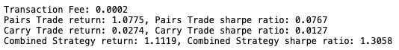
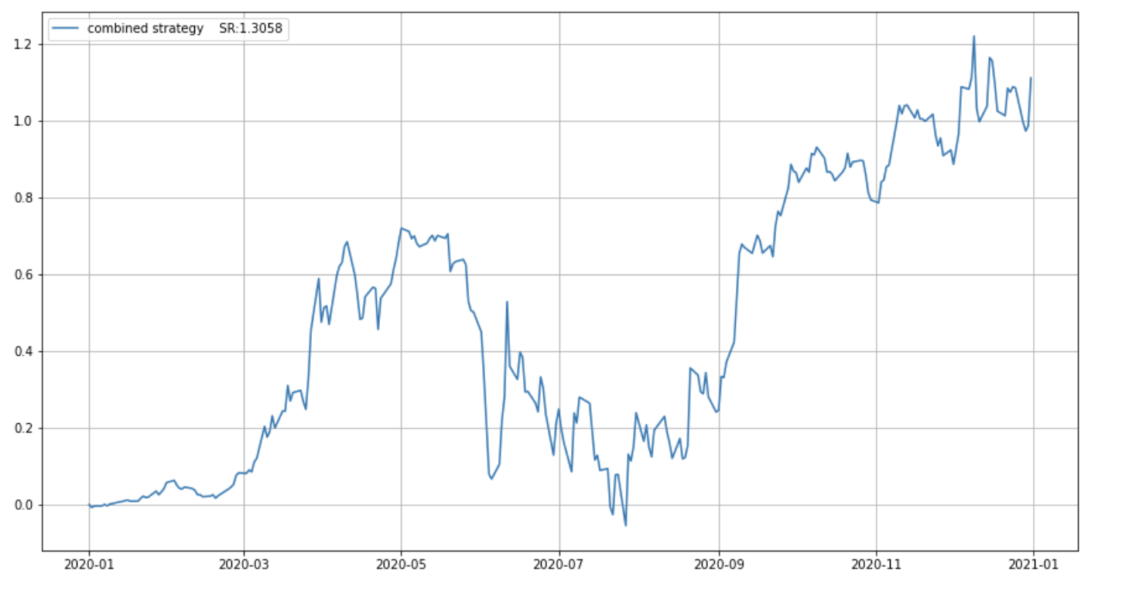
Hypothesis: Combined portfolio provides higher yield
Prelim Findings | Individual strategies |  |  |  | Combined Strategy
 | Pairs | Carry | Momentum | Value
Preliminary results:
Best combined portfolio so far is pair and carry combined (SR: 1.3058).
Value strategy does not enhance the combined Sharpe ratio (negative mean return).
But we intend to run tests on the Momentum strategy.
Economic intuition:
Carry + Pairs: While the carry trade has lower mean return and SR, it has hedging benefits due to low volatility to the overall portfolio with a higher volatility pair-trading (mean reversion).
Value strategy: Not yield enhancing due to unprecedented market dips and volatility in 2020 (COVID 19)
Diversification from Momentum: To test with momentum strategy, potentially due to market volatility using a dollar neutral strategy.
Strategy | Economic Intuition
Carry + pair | While the carry trade has lower mean return and SR, it has hedging benefits due to low volatility to the overall portfolio with a higher volatility pair-trading (mean reversion).
Value strategy | Not yield enhancing due to unprecedented market dips and volatility in 2020 (COVID 19)
Diversification from Momentum | To test with momentum strategy, potentially due to market volatility using a dollar neutral strategy.
Notes:
Here are the headline findings
Point attention to mean + SR of pairs & carry VS combined
We’ll now go into the mechanics of each strategy and its performance. I’ll hand the time over to Chuanyu.

Slide 5
Individual Trading Strategies
Methods & PnL backtest

Slide 6
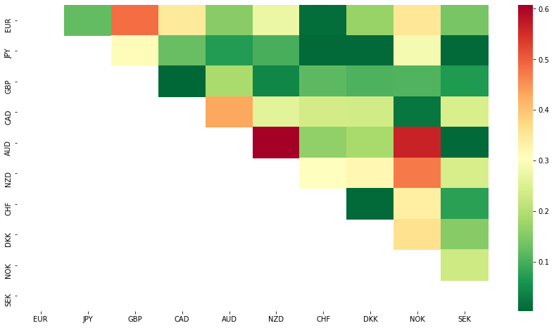
1) Pairs trading - Method
Prelim Findings | Individual strategies |  |  |  | Combined Strategy
 | Pairs | Carry | Momentum | Value
This strategy seeks to profit by opening long and short positions in two currencies with a high correlation. It is betting on mean reversion.
When pairs from the trade eventually deviate, we would seek to take a long position in the underperforming currency and sell short the outperforming currency. If the currencies return to their historical correlation, a profit is made from the convergence of the prices.
We first determine the higher correlated pairs for 1 year (heatmap on right), and then we take profit from the arbitrage between the moving averages of the chosen pairs using the spot rates.
Total of 11 most cointegrated pairs are selected for pair trading.
Notes:
Mario Carrasco Blazquex, Carmen De la Orden De la Cruz, Camilo Prado Roman. Pairs trading techniques: An empirical contrast. European Research on Management and Business Economics, Sep-Dec 2018, pp 160-167. (https://www.sciencedirect.com/science/article/pii/S2444883418300457)

Slide 7
1) Pairs trading - Method
Prelim Findings | Individual strategies |  |  |  | Combined Strategy
 | Pairs | Carry | Momentum | Value
Pair Ratiot = CurrencyXt/CurrencyYt , where spot rates at "t" are used.
We take the moving average (MA) of 5 days & 60 days and rolling standard deviation (STD) of 60 days of each pair ratio.
Compute the standardized difference between two periods of MA over STD as the Z-score:
Z-score = (MA5dt - MA60dt) / STD60dt
If Z-score is >1, long 1 position in currencyXt and short Pair Ratiot position of currencyYt, and vice versa.
If Z-score is between -0.5 and 0.5, close all open positions.
Notes:
Mario Carrasco Blazquex, Carmen De la Orden De la Cruz, Camilo Prado Roman. Pairs trading techniques: An empirical contrast. European Research on Management and Business Economics, Sep-Dec 2018, pp 160-167. (https://www.sciencedirect.com/science/article/pii/S2444883418300457)

Slide 8
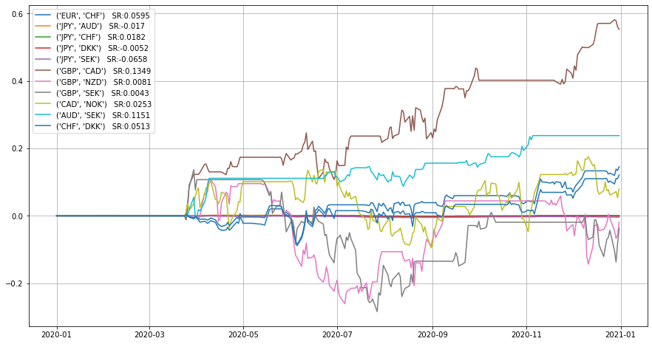
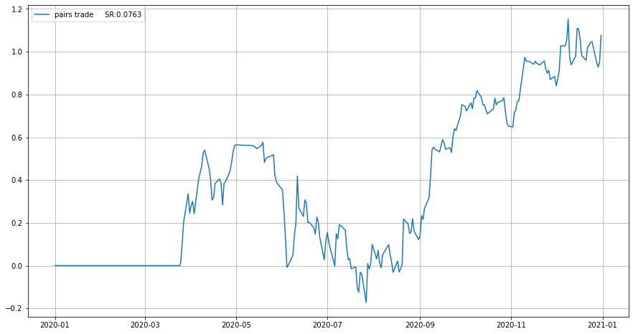
1) Pairs trading- Strategy Performance
Prelim Findings | Individual strategies |  |  |  | Combined Strategy
 | Pairs | Carry | Momentum | Value
The 11 pairs that achieved generally an acceptable sharpe ratio, from the pair construction that was taken. It was observed that the decreased sharpe occurred around June 2020 (60DMA) when the effect set in from most economies' adjustments to lockdowns due to the Covid pandemic.
Overall, the strategy on a yearly duration, showed only a slight yield significance on the 11 pairs traded with a sharpe ratio of 0.0763

Slide 9
2) Carry Trade - Method
Prelim Findings | Individual strategies |  |  |  | Combined Strategy
 | Pairs | Carry | Momentum | Value
Carry trade is one of the most popular trading strategies in FX market.
A carry trade involves borrowing a currency that has a lower interest rate (low yield) to fund the purchase of a currency that has a higher interest rate (high yield).
Holding this position over the period will result in an interest payment being made to the trader based on the “positive carry” of the trade.
Low interest rate currencies used as funding currencies include Yen and CHF.
High interest rate currencies used as lending currencies include AUD, GBP, NZD, etc.

Slide 10
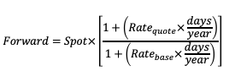
2) Carry Trade – Method
Prelim Findings | Individual strategies |  |  |  | Combined Strategy
 | Pairs | Carry | Momentum | Value
Interest Rate Parity represents the backbone of the carry trade strategy.
Interest rate differential (aka forward point) is equal to the differential between the outright forward rate and spot rate as shown in the equation:
The no arbitrage argument suggests carry trade strategy cannot benefit from interest rate differential without being exposed to currency risk.

Slide 11
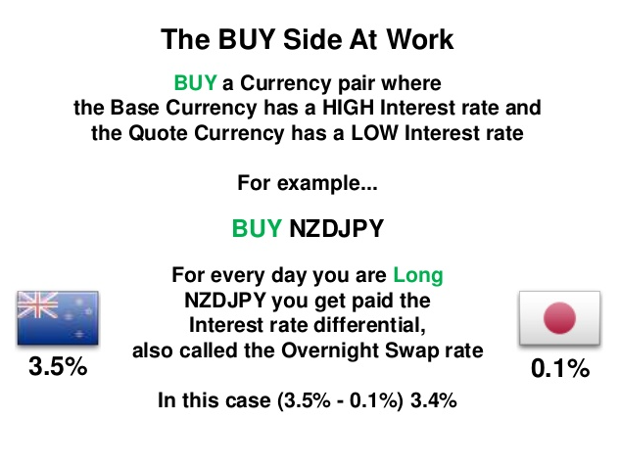
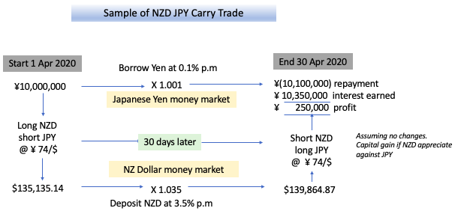
2) Carry Trade - Method
Prelim Findings | Individual strategies |  |  |  | Combined Strategy
 | Pairs | Carry | Momentum | Value

Slide 12
2) Carry Trade – Method
Prelim Findings | Individual strategies |  |  |  | Combined Strategy
 | Pairs | Carry | Momentum | Value
We form portfolios by sorting at the beginning of each month all currencies according to the value of forward premium (forward rate – spot rate).
Divide portfolios formed into quantiles.
Long portfolio of currencies with the highest forward premium, and short portfolio of currencies with the lowest forward premium.
Close carry trade position: If the portfolio of currencies returns < 50-quantile AND if market variance > median value, and vice versa.
Portfolio of currencies are rebalanced monthly.

Slide 13
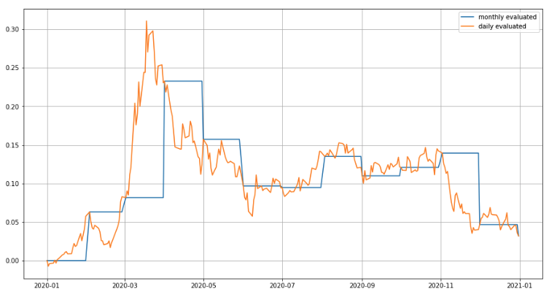
2) Carry Trade- Strategy performance
Prelim Findings | Individual strategies |  |  |  | Combined Strategy
 | Pairs | Carry | Momentum | Value
1 year Sharpe Ratio (SR) of 0.0274.
1 year mean return of 0.0127.
SR increased in late March due to stronger USD amid worsening Covid-19 situation.
Downward trend in carry trade SR since late March due to narrowing carrying spread as central banks worldwide cut rates.
Although carry trade itself has low mean return and SR, that doesn’t mean that carry trade is an unfeasible trading strategy. It could have hedging benefits that outweigh its low SR and be a good choice as part of a larger portfolio of combined strategies.

Slide 14
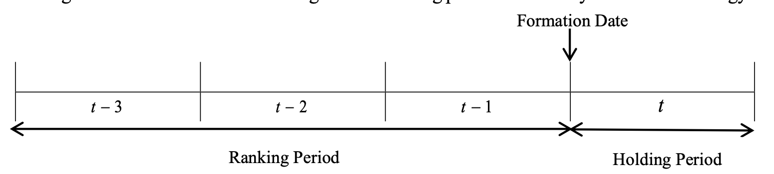
3) Momentum - Method
Prelim Findings | Individual strategies |  |  |  | Combined Strategy
 | Pairs | Carry | Momentum | Value
Momentum strategy, a technical trading strategy, aimed at buying securities that have been showing an upward price trend or short-selling securities that have been showing a downward trend.
The main rationale behind momentum investing is that once a trend is well-established, it likely to continue.
Momentum strategy suggests that investors are leveraging the behavioural weaknesses of other investors, such as the tendency to “follow the herd”, also known as the “herd mentality bias”.

Slide 15
3) Momentum Strategy - Dollar Neutral Portfolio
Prelim Findings | Individual strategies |  |  |  | Combined Strategy
 | Pairs | Carry | Momentum | Value
On the first trading day of each month, we calculate each currency’s most recent ​N​-month momentum (​N ∈​ {1, 3, 12}).
We create dollar-neutral portfolios by going long the futures of the three currencies with the highest momentum and short the futures of the three with the lowest momentum.
Monthly factor performance corresponds to the return of the long portfolio minus the return of the short portfolio.
Rebalanced at the beginning of each month.

Slide 16
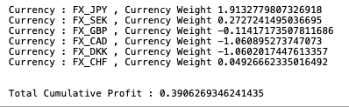
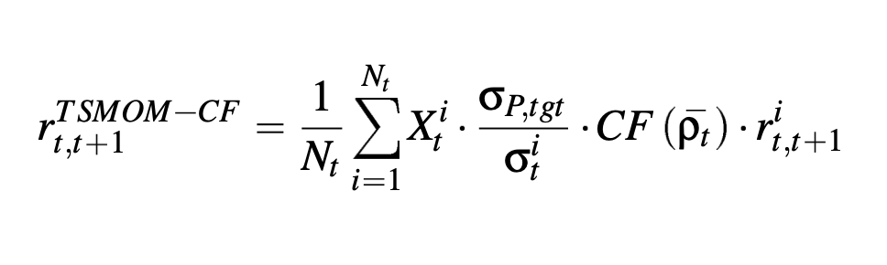
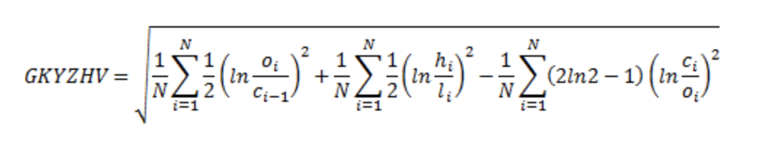
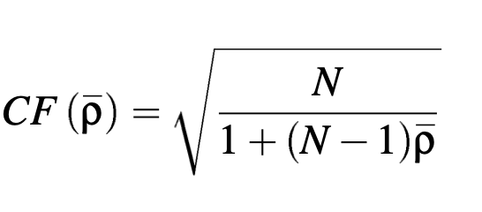
Prelim Findings | Individual strategies |  |  |  | Combined Strategy
 | Pairs | Carry | Momentum | Value
TSMOM
Dollar neutral Portfolio
TREND Trading Signal - t-statistics of historical daily log-returns to reflect the
strength of price movement trend - TREND Signal Conditions:
t-stat > 1 => TREND Signal = 1 t-stat < 1 => TREND Signal = -1 -1 < t-stat < 1 => TREND Signal = t-stat
Volatility : Yang and Zhang Volatility Estimator
Correlation Factor (CF)
Function of the average pairwise correlation of all portfolio contituents - the calculation is based on past three month pairwise correlation
Portfolio Weight
Data lag : 30 days
Investment Amount : 1
Duration with 1 Year
No – Rebalancing
Data lag : 30 days
Portfolio Constraints :
1. Dollar Neutral : long – short =0
Notes:
increasing the efficiency of volatility estimates can result in significant economic benefits for a risk-averse investor that dynamically rebalances a mean-variance optimised portfolio

Slide 17
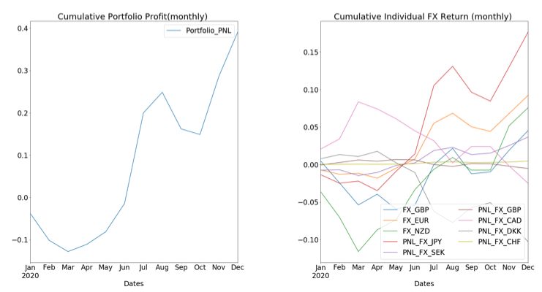
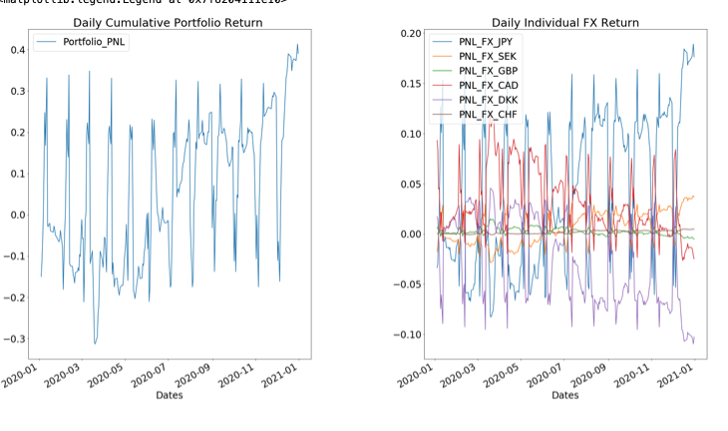
3) Momentum - Strategy Performance
Prelim Findings | Individual strategies |  |  |  | Combined Strategy
 | Pairs | Carry | Momentum | Value

Slide 18
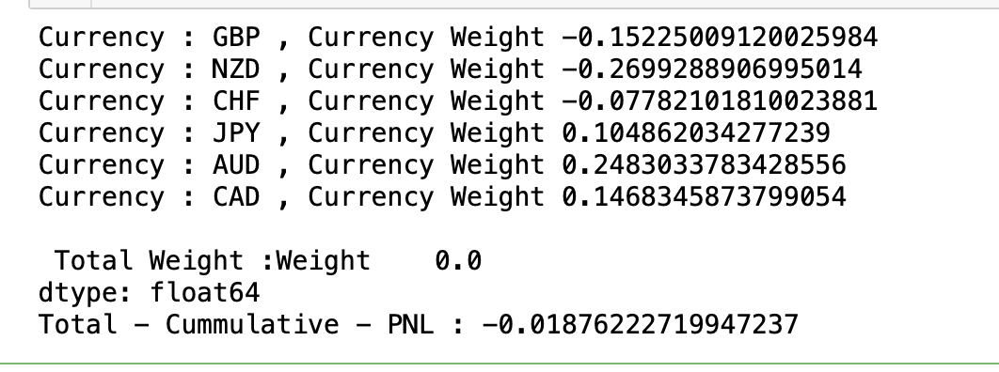
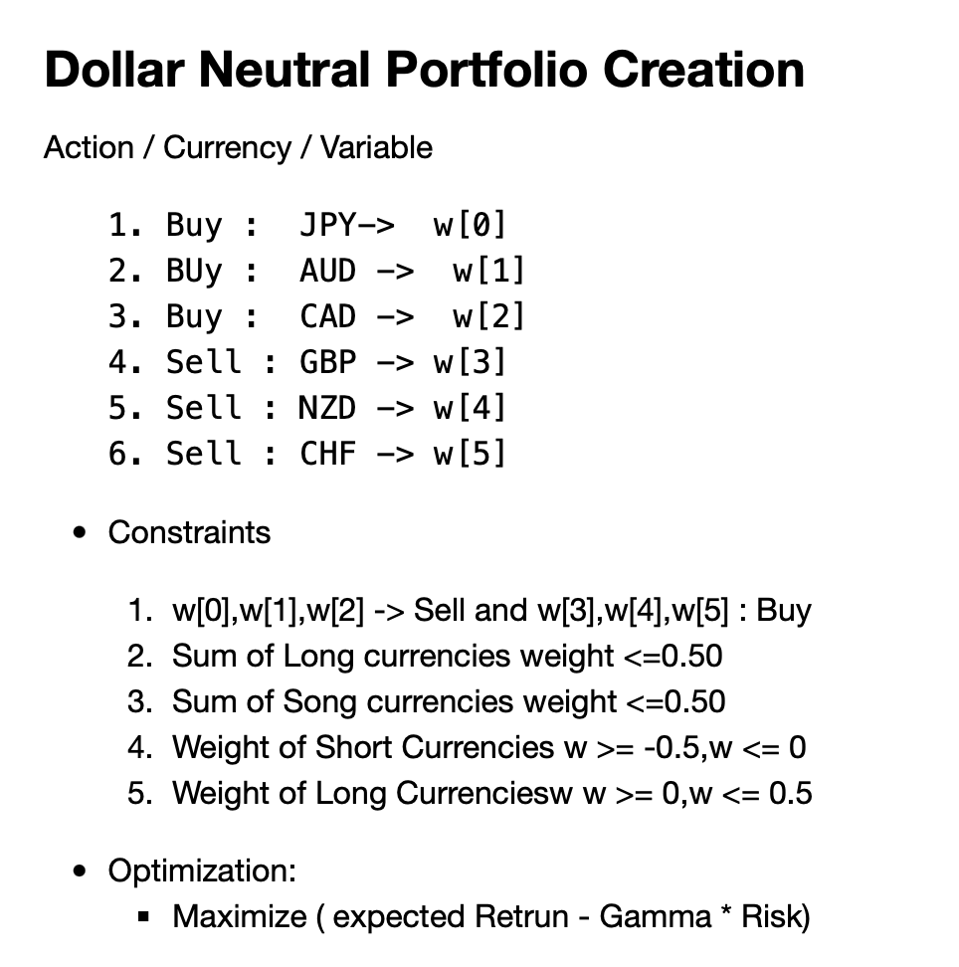
4)Value – Strategy Dollar Neutral Portfolio
Prelim Findings | Individual strategies |  |  |  | Combined Strategy
 | Pairs | Carry | Momentum | Value
Portfolio Weight
Data lag : 30 days
Purchasing Power Parity Theory (PPP)
Exchange rates between two currencies should equal the ratio of the price levels of a fixed basket of goods and services between those two countries.
Higher inflation directly proportional to currency depreciation in order to return to long-term parity.
Steps
On the first trading day of each month, we calculate each currency’s value score as the ratio of the currency's spot rate over its PPP a year prior
Select three currencies that are the most undervalued and short the futures of the three that are the most overvalued.
Portfolio Creation – Assigning appropriate weight
The monthly factor performance corresponds to the return of the long portfolio minus the return of the short portfolio.
Notes:
increasing the efficiency of volatility estimates can result in significant economic benefits for a risk-averse investor that dynamically rebalances a mean-variance optimised portfolio

Slide 19
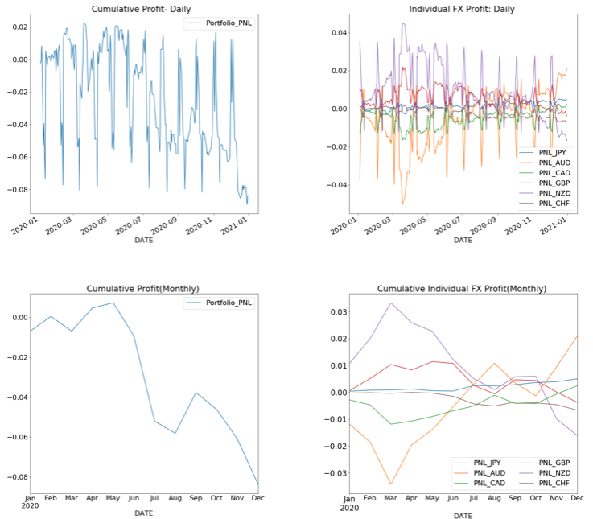
4) Value - Strategy Performance
Prelim Findings | Individual strategies |  |  |  | Combined Strategy
 | Pairs | Carry | Momentum | Value

Slide 20
Combined Strategy
Enhanced PnL hypothesis and next steps

Slide 21
Conclusion
Prelim Findings | Individual strategies |  |  |  | Combined Strategy
 | Pairs | Carry | Momentum | Value
Based on our investigation for achieving the best return and Sharpe Ratio, we have combined Carry and Pairs strategy. The combination remain stable even during extreme market stress conditions in 2020 with a higher combined than the respective individual SRs.
We excluded Value strategy due to negative returns attributable to the volatility from COVID 2019.
We would consider including the Momentum Method later due to possibility of profit that can be reaped from a volatile market from a dollar neutral strategy.

Slide 22
Thanks for your attention! Q&A

